Slide 1

ANALYSIS OF SETTING UP HOTELS IN DIFFERENT STATES
-BY Rohit Raj(20ME01031)
Contact @ 20me01031@gmail.com

Slide 2

Q1
Which state has the highest number of hotels? Depict this via a bar graph that compares all states.

Slide 3
From the bar graphs generated from the data sets provided , it can be concluded that, KERALA is the state with highest number of hotels

Slide 4
Q2
Which states have three types of climatic conditions? (convert the map, an unstructured data, to an Excel file in a structured format and mention the number of climates along with the state)

Slide 5
SOLUTION
From the map provided in the problem statement, which is unstructured data, On structuring them in MS excel , I prepared the following table given in the next page.
On reading the table and analyzing the data, It has been found that the states with more than three climatic conditions are :-
MAHARASTRA | KARNATAKA | TAMIL NADU | MADHYA PRADESH | GUJARAT | WEST BENGAL | HARYANA
PLEASE VIEW THE TABLE IN THE NEXT PAGE

Slide 6
Tropical monsoon | Tropical savannah, wet & dry | Arid, steppe, hot | Humid subtropical | Mountain climate | Hot desert arid
Western Maharashtra | Maharashtra | Maharashtra | UP | Ladakh | Gujrat
Goa | MP | Telangana | MP | J&K | Rajasthan
Western Karnataka | Gujrat | Gujrat | Chhattisgarh | H.P. | Punjab
Kerala | Chhattisgarh | Karnataka | Uttarakhand | Uttarakhand | Haryana
Tamil Nadu | Odisha | Andhra Pradesh | Haryana | Sikkim
 | Jharkhand | Tamil Nadu | H.P | W.B.
 | West Bengal | Himachal Pradesh | Chhattisgarh | Assam
 | Telangana | Rajasthan | Jharkhand | Arunachal Pradesh
 | Andhra Pradesh | MP | Bihar
 | Karnataka | Uttar Pradesh | West Bengal
 | Tamil Nadu | Haryana | Meghalaya
 |  | Punjab | Manipur
 |  |  | Nagaland
 |  |  | Assam
 |  |  | Arunachal Pradesh

Slide 7
Q3
Among the northeastern states which are best to set up a hotel? Use Clustered Column Chart and give recommendations for hotel industry investors.

Slide 8
NOTES TO TACKLE THIS QUESTION:-
I have included Bihar in North-eastern states also as it comes in that area.
I don't think the data provided --> number Of hotels is enough for analyzing the business prospects of setting up the hotel
I firmly believe that tourists are the main source of income for these hotels.
So, I have added columns with domestic and foreign tourist in the dataset , these data are taken from official Indian tourism data provided by Govt. Of India.
Then , I have drawn the chart that is provided in the upcoming slides

Slide 9
Serial No.​ | North-Eastern States​ | Number of Hotels​ | Number of domestic tourists​ | Number of foreign tourists​
1​ | Arunachal Pradesh​ | 5000​ | 102915​ | 182​
2​ | Assam​ | 25000​ | 1409161​ | 536​
3​ | Bihar​ | 4000​ | 2501193​ | 1046​
4​ | Manipur​ | 3000​ | 49371​ | 648​
5​ | Meghalaya​ | 2000​ | 154409​ | 411​
6​ | Mizoram​ | 1000​ | 87232​ | 234​
7​ | Nagaland​ | 1000​ | 23968​ | 325​
8​ | Sikkim​ | 12000​ | 511669​ | 11508​
9​ | Tripura​ | 1000​ | 177816​ | 5​

Slide 10
Final clustered column chart considering tourists

Slide 11
Conclusion:-
TRIPURA & MEGHALAYA is the state with most potential as the customer to hotel ratio is very less.
Bihar is the most profitable state to set up hotels, but it does not come under official northeastern states.
Nagaland should be avoided considering the less no. of tourists Visiting there.
Assam is also a good location to invest in hotels.
These are very premature conclusion based on only few data variables. For better analysis, we must have to consider cost of land, construction cost , Govt. Restrictions ,taxes etc. also.

Slide 12
Q4
Customize the pivot charts to add/change the fields in the fields list with other fields and by using chart styles to customize the charts. (choose the data and parameters according to your choice)

Slide 13
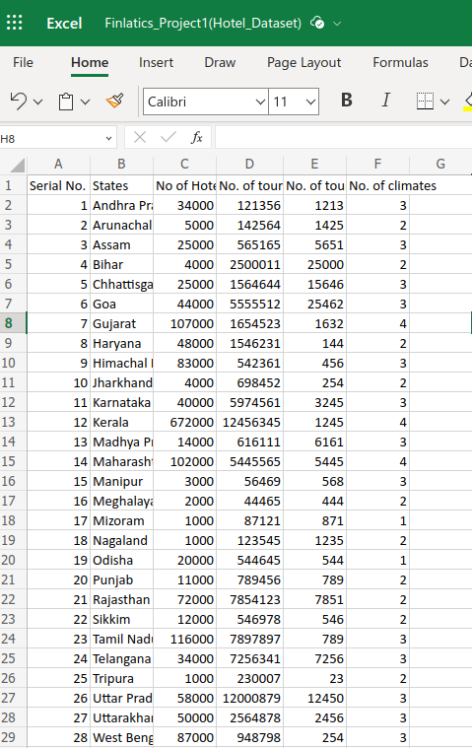
Excel layout with 3 more data(random)

Slide 14
Pivot Charts with few more columns
Q4 is not clear about what exactly we have to do.

Slide 15
Q5
Which is the best state for setting up a hotel? Why?

Slide 16
NOTES TO TACKLE THIS QUESTION:-
I don't think the data provided --> number Of hotels is enough for analyzing the business prospects of setting up the hotel.
I firmly believe that tourists are the main source of income for these hotels.
So, I have taken the climatic condition as well as number of tourist in consideration also.
So, I have added columns with domestic and foreign tourist in the dataset , these data are taken from official Indian tourism data provided by Govt. Of India.
For better analysis, we must have to consider cost of land, construction cost , Govt. Restrictions ,taxes etc. also.

Slide 17
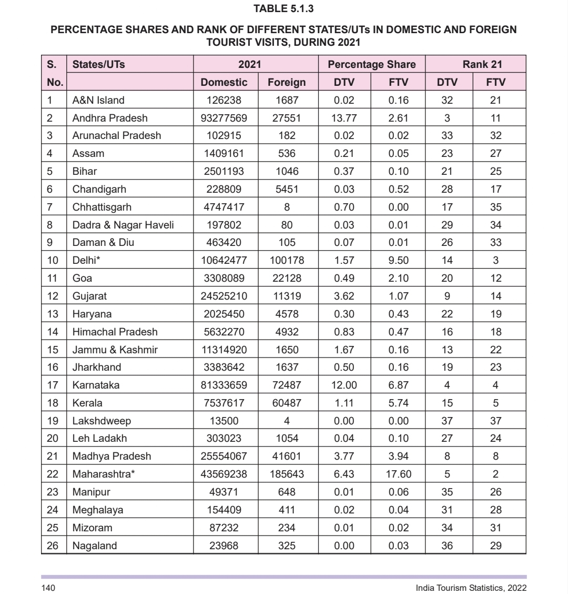
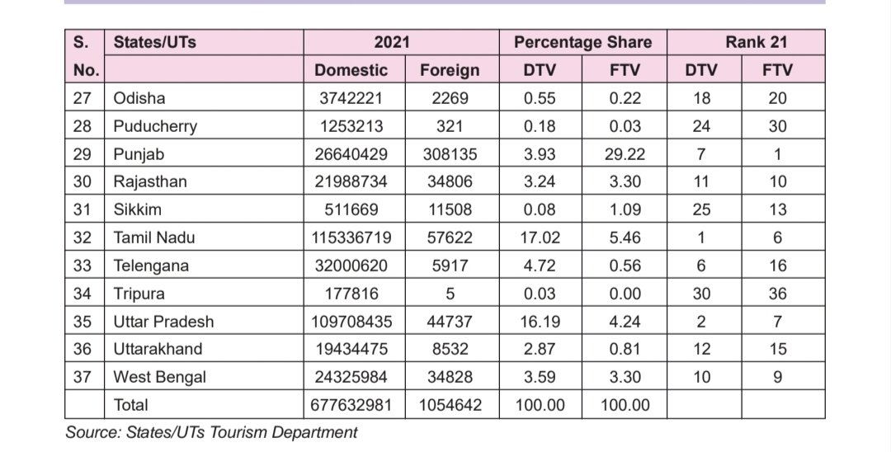
Source : Indian Tourism official data

Slide 18
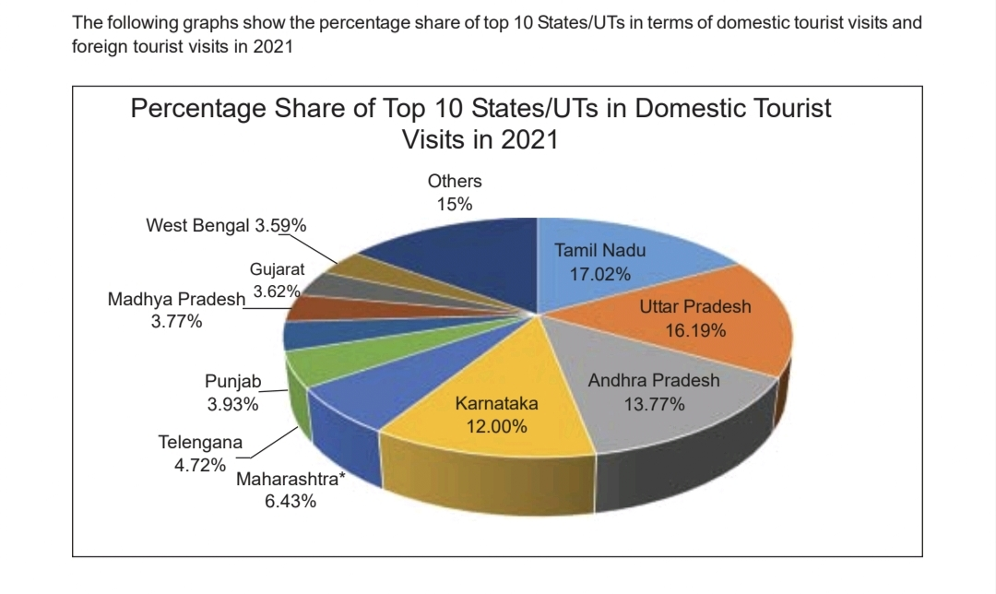
Source : Indian tourism official data(Govt. Of India)

Slide 19
Conclusion
ANDHRA PRADESH & UTTAR PRADESH are the two locations with maximum tourist share as per official data. Also, The number of hotels existing is less and So, they can be preferred to open Hotels
KARNATAKA & TAMIL NADU have 3 climatic conditions and, also comprises good tourist share. So, These are potentially good location for setting up hotel.
These are very premature conclusion based on only few data variables. For better analysis, we must have to consider cost of land, construction cost , Govt. Restrictions ,taxes etc. also.

Slide 20
Q6
What is the average number of days the rainy season lasts in Indian states?

Slide 21
TABLE from the given data:
Climate | No. Of days | Timeline
Tropical Monsoon | 136 | 1 June - 15 October
Tropical savannah wet and dry | 136 | 1 June - 15 October
Arid steppe hot | 136 | 1 June - 15 October
Humid subtropical | 122 | 5 June – 1 October
Montane climate | 102 | 1 June – 15 September
Hot Desert Arid | 92 | 15 June – 1 September
Average | 120.667

Slide 22
Conclusion
The average number of days , the rainy season lasts in Indian states is around 121 days
Generally, The monsoon or rainy season in India lasts from June till September
∙ The south-west monsoon, known as the summer monsoon brings most of the rainfall during a year in the country

